Slide 1

BUDGET SALES ANALYSIS OF COMPUTER HARDWARE MANUFACTURER
By
Sahil Kumar
Namrata Patel
Pinal Gajjar

Slide 2
Abstract
AtliQ Hardware Technologies, established in 2017, is an IT services company operating in the United States and India.
Over the past 6 years, AtliQ has provided customized solutions to businesses worldwide, enhancing efficiency, reducing costs, and fostering growth. As a multinational firm, they prioritize data-driven decision-making and aim to embed analytical tools in their work culture.
To enhance their market strategies, AtliQ is undertaking a project to leverage data insights for smarter decision-making in the competitive tech industry. By exploring the potential impact of weather conditions on sales through data analysis, they seek to uncover correlations between weather patterns and sales performance. The ultimate goal is to empower AtliQ to make informed decisions, adapt to market changes, and foster innovation for sustained success.

Slide 3
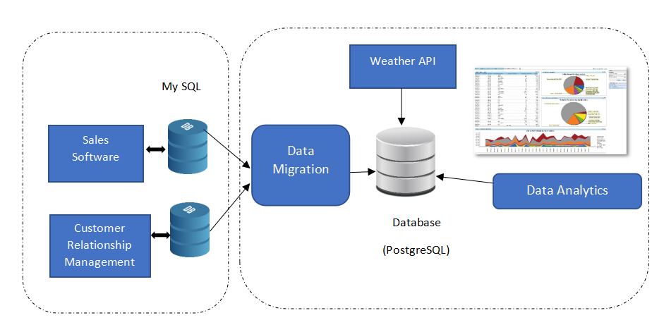
Project Architecture

Slide 4
Project Objective
1. Financial Analysis
- Objective: Optimize performance through in-depth analysis.
- Approach: Explore profit and loss across markets, products, regions.
- Outcome: Targeted improvement strategies.
2. Budget Sales Analysis
- Objective: Drive quick insights and informed decisions.
- Approach: Analyze computer hardware manufacturing budget sales.
- Benefits: Strategic planning agility and adaptation to trends.
3. Weather and Hardware Sales
- Objective: Understand weather's impact on sales.
- Approach: Analyze historical sales with weather correlation.
- Outcome: Insights from the weather API correlation with the sales in USA and India

Slide 5
EDA (Exploratory Data Analysis)
1 Null Value Analysis
2 Summary Statistics
2.1 Numerical Statistical Analysis
2.2 Categorical Statistical Analysis
3 Duplicate Value Analysis
4 Univariate Analysis
4.1 Categorical columns univariate analysis
4.2 Numerical columns univariate analysis
5 Bivariate Analysis
6 Multivariate Analysis

Slide 6
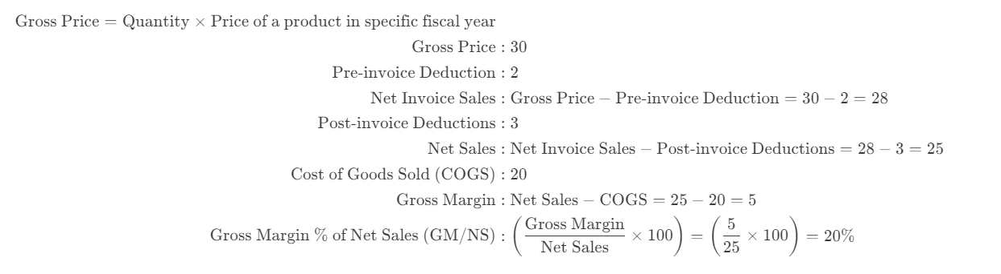
Navigating Financial Dynamics: Formulas for Profit & Loss, Gross Price Calculations According to Fiscal Year

Slide 7
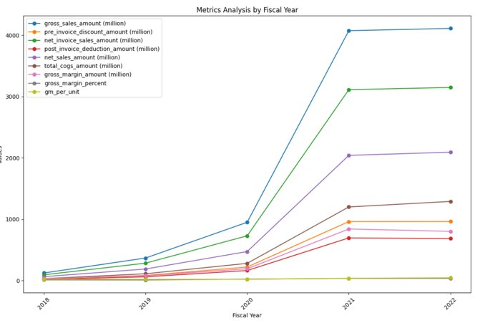
Metrics Analysis by Fiscal Year

Slide 8
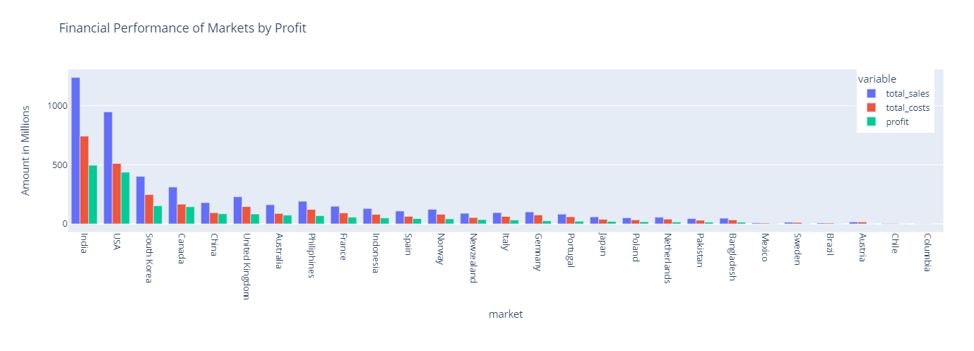
Financial Analysis
Country wise Profit and Loss Analysis

Slide 9
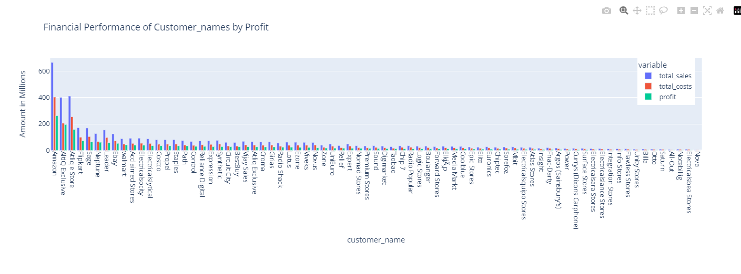
Financial Analysis
Customer wise Profit and Loss Analysis

Slide 10
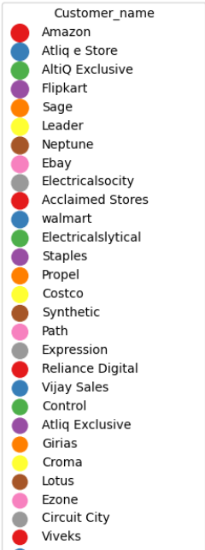
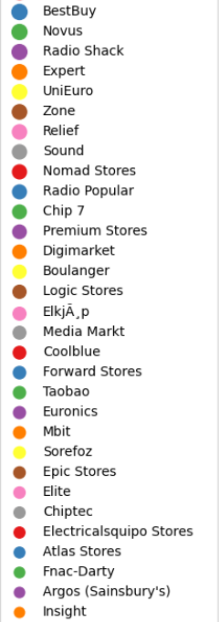
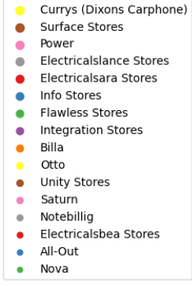
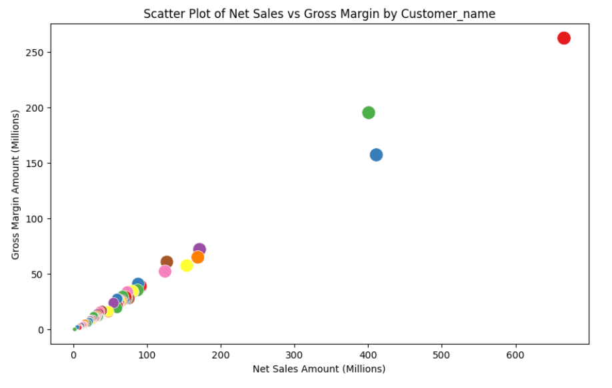
Budget Sales Analysis
Net Sales vs Gross Margin By Customer
High Net Sales with Moderate Margin
Low Net Sales, Decent Margins
High Sales with High Margins
Marginal or Negative Performance

Slide 11
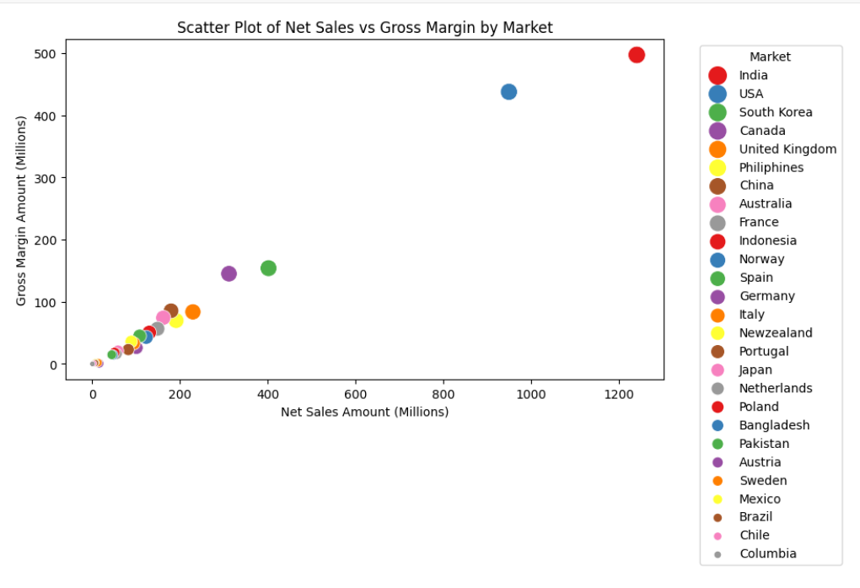
Budget Sales Analysis
Net Sales vs Gross Margin
By Market
High Sales with Strong Margins
Balanced Performance
Varying Sales and Margins
European Markets
Underperforming Markets
Very Low Performance

Slide 12
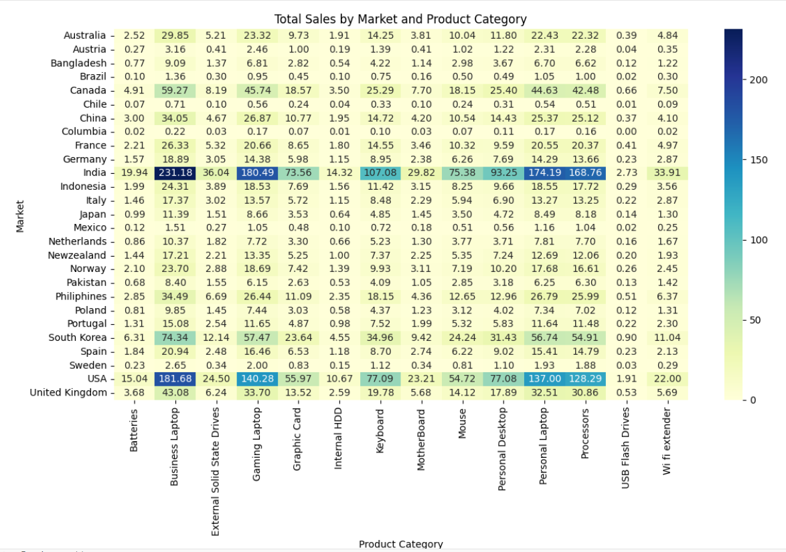
Budget Sales Analysis
Correlation
Market vs
Product Categories

Slide 13
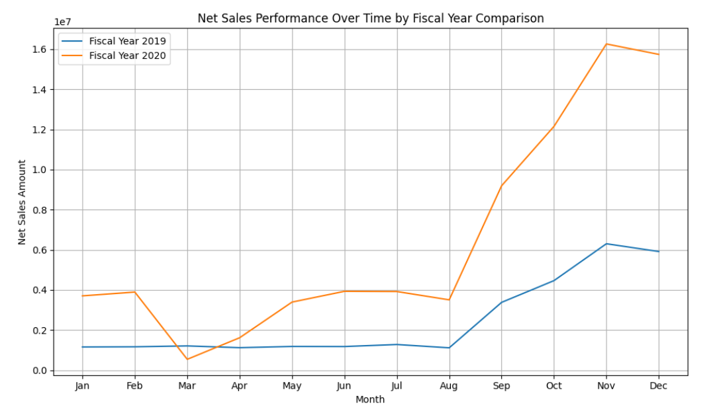
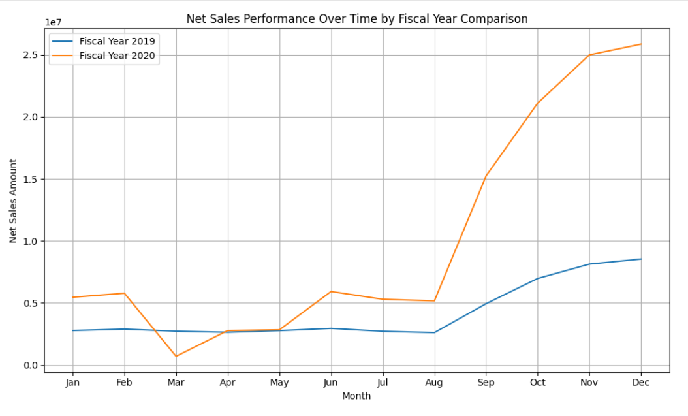
Seasonal Trends in USA And India
USA
India

Slide 14
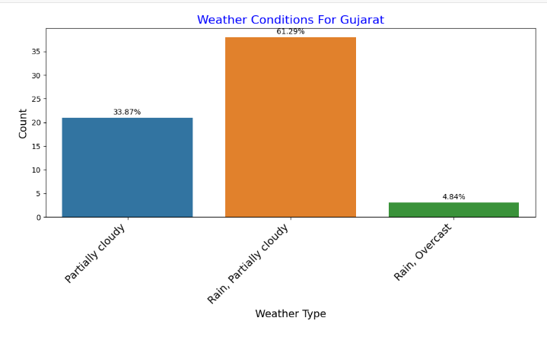
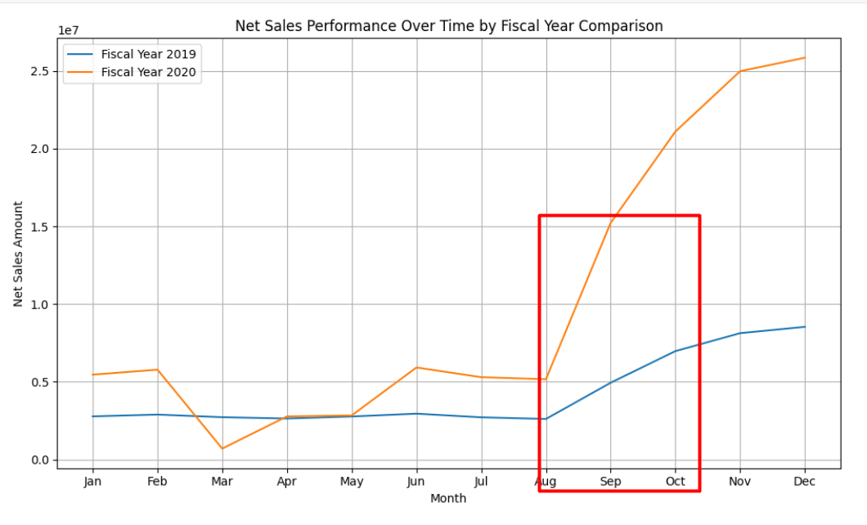
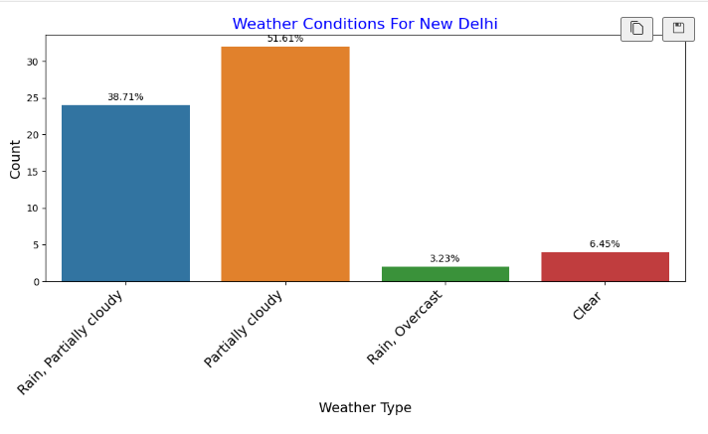
Seasonal Trends in India For Sales Increase
Weather Conditions Vs Net Sales Performance Observation between Aug 2020- October 2020 in India For Gujarat and New Delhi
Amazon News – Great Indian Festival
https://www.indiatoday.in/information/story/amazon-great-indian-festival-2020-sale-great-offers-on-smartphones-tv-and-electronics-1732252-2020-10-16
Amazon: High performing Cities of India : Gujarat, New Delhi
https://sell.amazon.in/grow-your-business/amazon-global-selling/blogs/top-10-indian-states-for-exports#:~:text=New%20Delhi%20is%20one%20of,Amazon%20Global%20Selling%20%E2%80%94%20over%2020%2C000
Weather API
https://weather.visualcrossing.com/

Slide 15
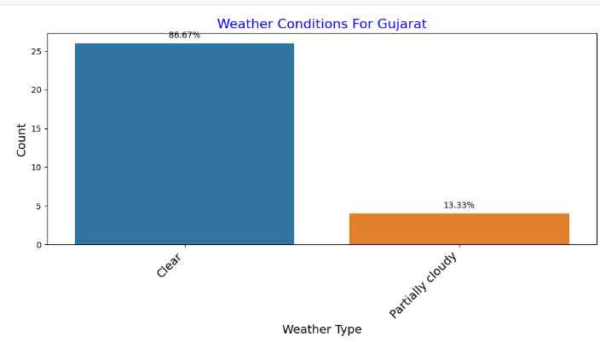
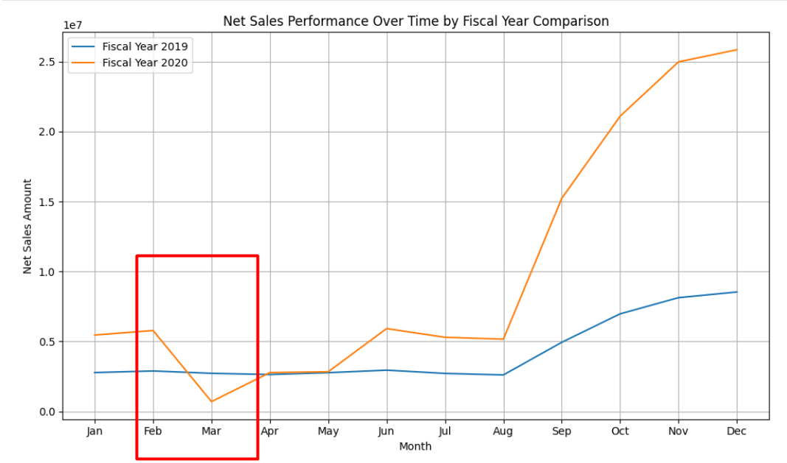
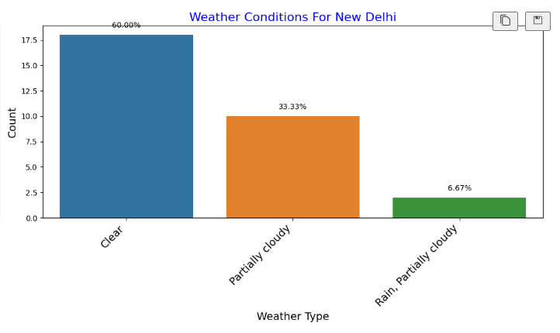
Seasonal Trends in India For Sales Decrease
Weather Conditions Vs Net Sales Performance Observation between Feb 2020- March 2020 in India For Gujarat And New Delhi
Probably due to other factors Like Covid-19 cases started to increase in India after February 2020
Probably due to hardware imports from China, as China was severely affected by Covid-19 during that period
Weather API
COVID-19 pandemic cases in February 2020 - Wikipedia
https://weather.visualcrossing.com/

Slide 16
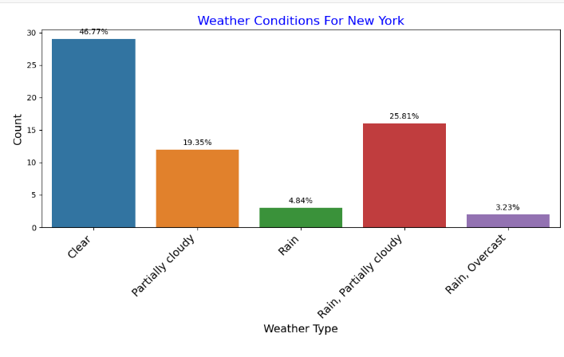
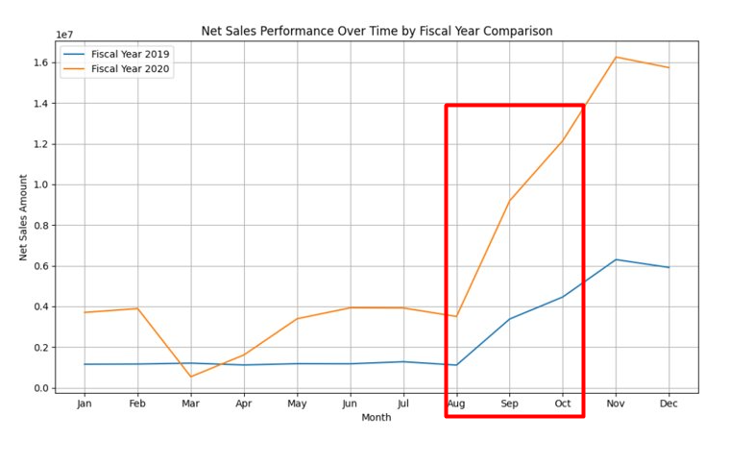
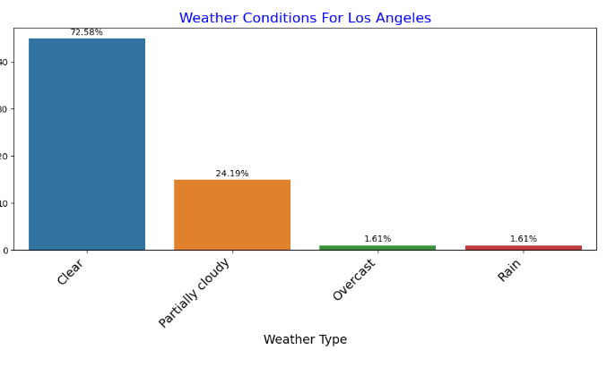
Seasonal Trends in USA For Sales Increase
Weather Conditions Vs Net Sales Performance Observation between Aug 2020- October 2020 in USA For New York And Los Angeles
Amazon News
https://press.aboutamazon.com/2020/10/amazon-prime-day-2020-marked-the-two-biggest-days-ever-for-small-medium-businesses-in-amazons-stores-worldwide
Weather API
https://weather.visualcrossing.com/

Slide 17
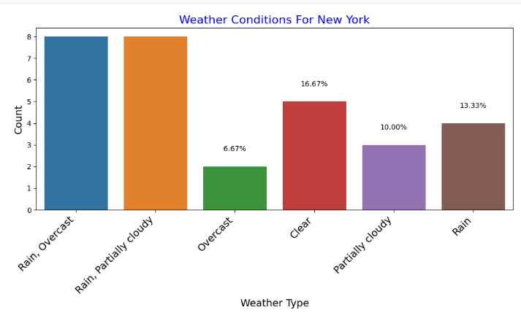
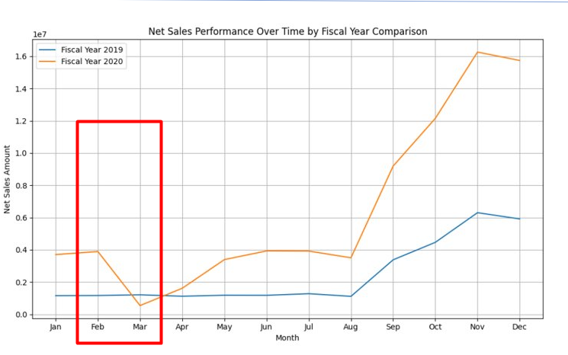
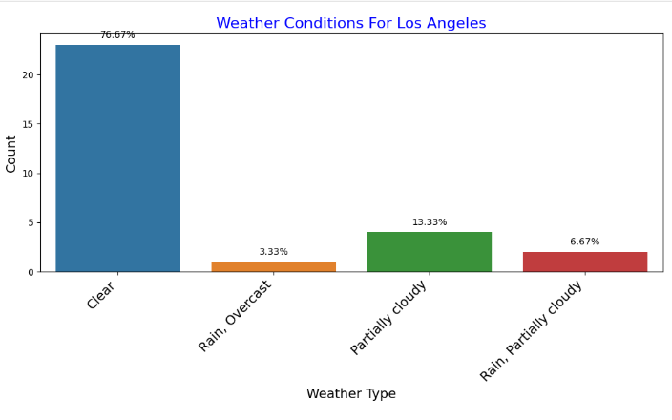
Seasonal Trends in USA For Sales Decrease
Weather Conditions Vs Net Sales Performance Observation between Feb 2020- March 2020 in USA For New York And Los Angeles
Amazon News
https://press.aboutamazon.com/2020/10/amazon-prime-day-2020-marked-the-two-biggest-days-ever-for-small-medium-businesses-in-amazons-stores-worldwide
Weather API
https://weather.visualcrossing.com/

Slide 18
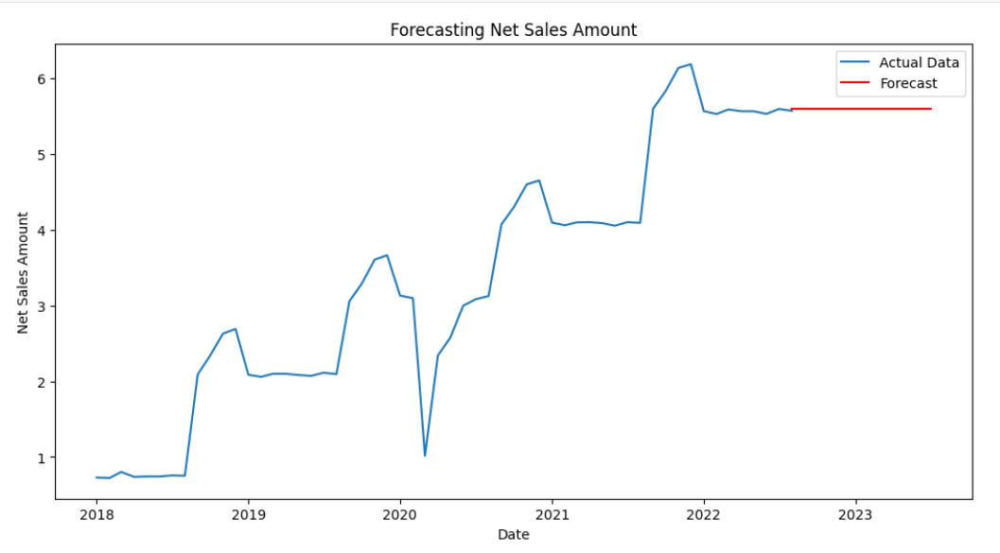
Additional Features
Time Series : Forecasting Net Sales Amount

Slide 19
Challanges
My Sql to Postgres Data Migration
Seasonal Trends using Weather API
Domain Knowledge regarding sales

Slide 20
Conclusion
Financial analysis (2018-2022) highlights consistent sales growth, improved profitability, and regional variations. Key products, customers, and divisions impact sales and profits, with Brick & Mortar and Retailer channels dominating.
Budget sales analysis emphasizes leadership markets (USA, India) and influential customers (Amazon, AltiQ Exclusive). We prioritized top-performing product categories for strategic budget allocation.
For seasonal trends, we could not derive the outcomes based on the weather API results and the dataset. But we tried to provide high level insights based on our research.
In summary, the analysis provides a concise understanding of sales dynamics, weather impacts, and external influences, offering actionable insights for businesses to enhance decision-making and strategic planning.

Slide 21
Q & A

Slide 22
References
https://openweathermap.org/history
https://docs.python.org/3/library/logging.html
https://hevodata.com/learn/mysql-to-postgresql/
https://builtin.com/data-science/pandas-pivot-tables
https://towardsdatascience.com/feature-engineering-in-python-part-i-the-most-powerful-way-of-dealing-with-data-8e2447e7c69e

Slide 23
Source Code
Git Hub Link
https://github.com/Namrata-Patel/AIM-5001/tree/master/Final_Project

Slide 24
THANK YOU

